Slide 1

Fundamental Of Structured Programming Lecture 11
Dr. Ahmed Yousry
Lecturer, Computer Science Department,
Faculty of computers and artificial intelligence, benha university

Slide 2


Slide 3
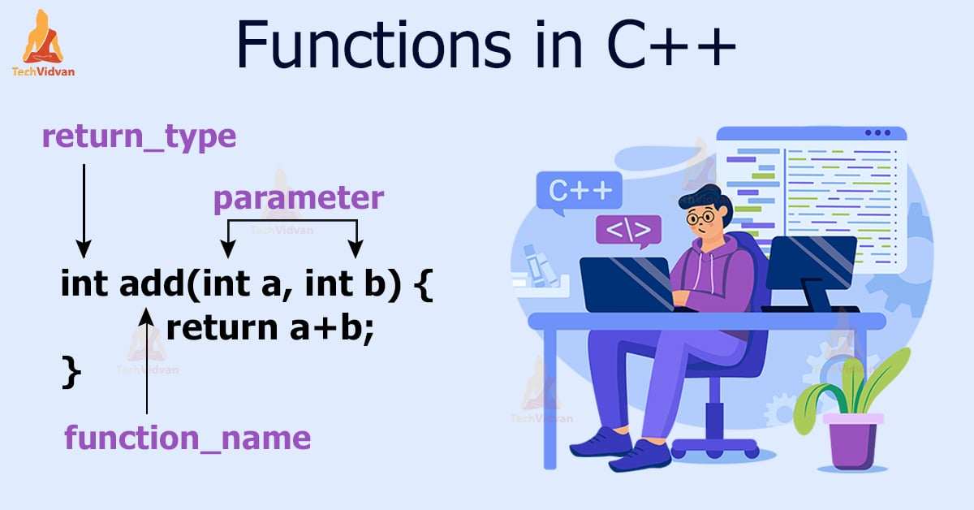

Slide 4

Passing Arguments to Functions Pass by Value & Pass by Reference

Slide 5

Passing Arguments to Functions
COPY
Passing Arguments by Value
Passing Arguments by Reference

Slide 6
Pass by Value
By default, arguments in C++ are passed by value.
Passing a variable by value makes a copy of the variable before passing it onto a function.
This means that if you try to modify the value inside a function, it will only have the modified value inside that function.
Once the function returns, the variable you passed it will have the same value it had before you passed it into the function.

Slide 7
Pass by Value Example
int main()
{
int b = 5;
cout << b << endl;
test(b);
cout << b << endl;
return 0;
}
void test(int x)
{
cout << x << endl;
x = 6;
cout << x << endl;
}
Address | Variable | Memory
300 | b | 5
304
308
Output
5
5
6
5
304 | x | 6
304 | x | 5

Slide 8
Pass by Value
COPY
Advantages of passing by value
Arguments are never changed by the function being called, since a copy of the argument (not the argument itself) is passed to the function, which prevents side effects.
Arguments passed by value can be variables (e.g. x), expressions (e.g. x + 1), or literals (e.g. 6).
Disadvantages of passing by value
Copying large structs can take a lot of time to copy, and this can cause a performance penalty, especially if the function is called many times.

Slide 9
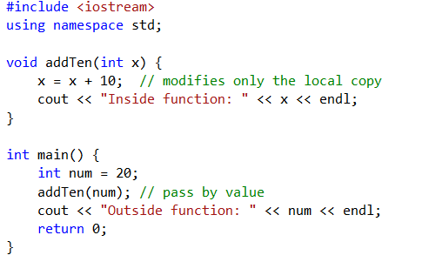
Example
Program Output:
Inside function: 30
Outside function: 20

Slide 10
Pass by reference

Slide 11
Pass by Reference
A reference variable accesses the memory location of another variable.
Any change made to the parameter is actually made to the variable in the calling function.
Reference variables are defined like regular variables, except there is an ampersand (&) between the data type and the name.
Example:
void prevnext (int x, int& prev, int& next) { prev = x-1; next = x+1; }

Slide 12
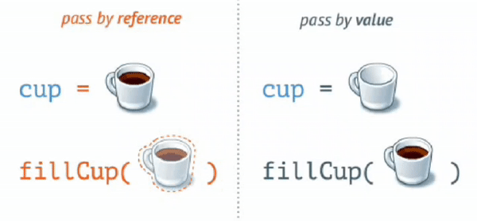
Pass by Reference
There are two cases where a variable is passed by reference:
When you want to modify the value of the passed variable and also the value of the variable in the calling function as well.
To avoid making a copy of the variable for efficiency reasons.

Slide 13
Pass by Reference Example
int main()
{
int b = 5;
cout << b << endl;
test(b);
cout << b << endl;
return 0;
}
void test (int &x)
{
cout << x << endl;
x = 6;
cout << x << endl;
}
Address | Variable | Memory
300 | b | 5
Output
5
5
6
6
x is an alias of b
Address | Variable | Memory
300 | b | 6

Slide 14
Pass by Reference
Advantages of passing by reference
It allows us to have the function change the value of the argument, which is sometimes useful.
Because a copy of the argument is not made, it is fast, even when used with large memory (structs).
We can return multiple values from a function.

Slide 15
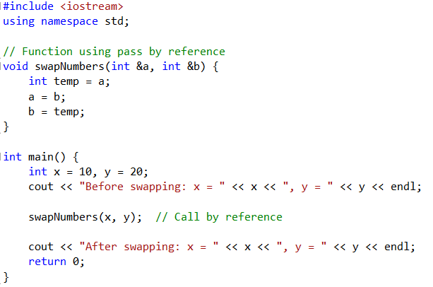
Example
Program Output:
Before swapping: x = 10, y = 20
After swapping: x = 20, y = 10

Slide 16
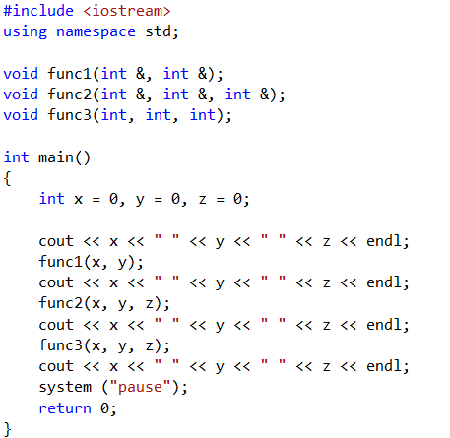
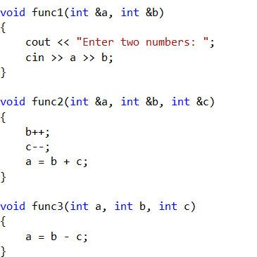
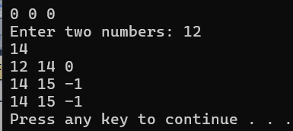
What is the output if the user enters 12 and 14?

Slide 17
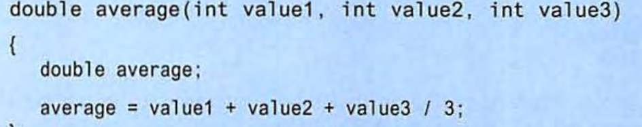
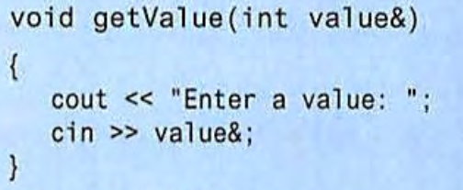
Find the error
average=(value1+value2+value3)/3;
return average;
void getValue (int & value )
{ cout<<"enter avalue : “;
cin>>value;
}

Slide 18
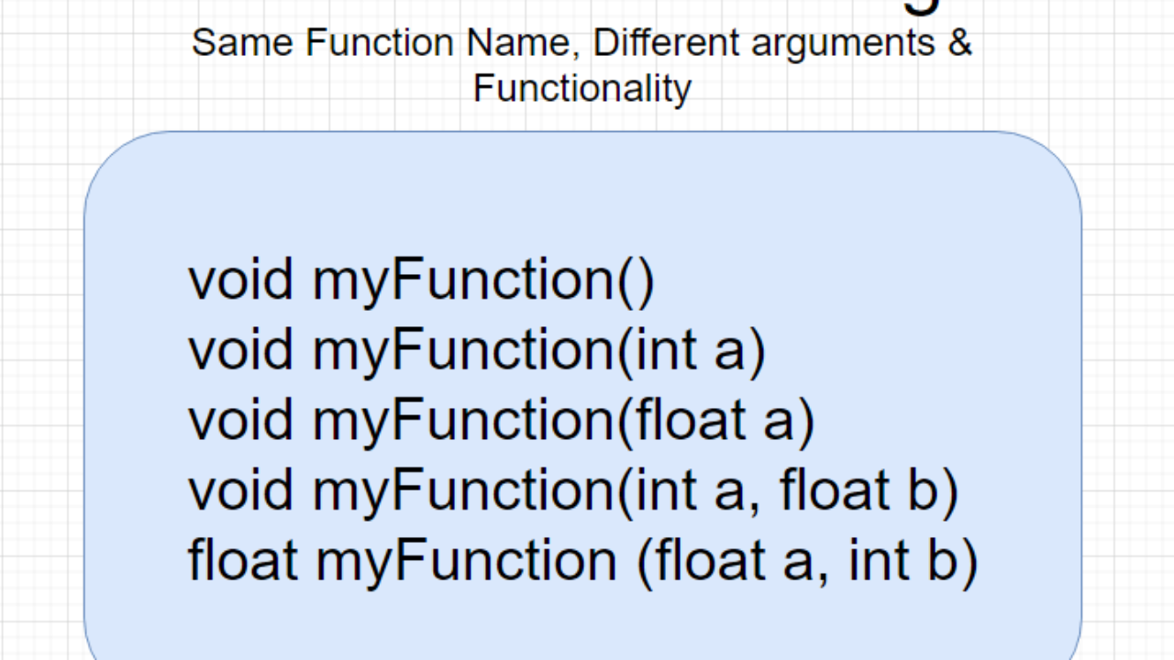
Overloaded Functions
Overloaded functions have the same name but different parameter lists
Two different functions can have the same name if their parameter types or number are different
Can be used to create functions that perform the same task but take different parameter types or different number of parameters
Compiler will determine which version of function to call by argument and parameter lists
You can give the same name to more than one function if they have either a different number of parameters or different types in their parameters.

Slide 19
Function Overloading Examples
Using these overloaded functions,
void getDimensions(int); // 1
void getDimensions(int, int); // 2
void getDimensions(int, double); // 3
void getDimensions(double, double);// 4
the compiler will use them as follows:
int length, width;
double base, height;
getDimensions(length); // 1
getDimensions(length, width); // 2
getDimensions(length, height); // 3
getDimensions(height, base); // 4

Slide 20
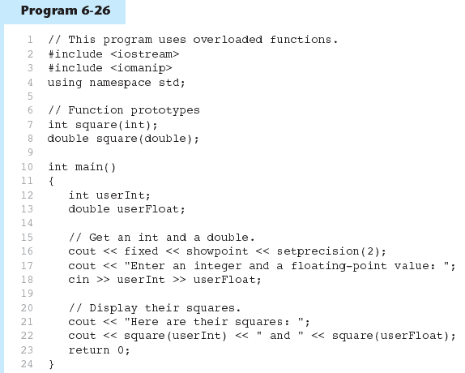
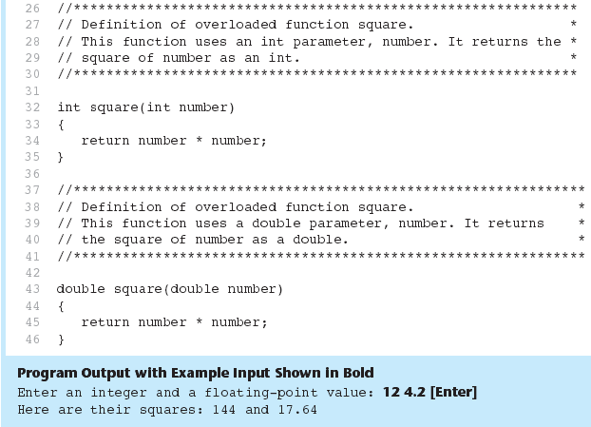

Function Overloading
The overloaded functions have different parameter lists
Passing a double
Passing an int

Slide 21
Overloaded Functions Example
// overloaded function #include <iostream> using namespace std; int operate (int a, int b) { return (a*b); } float operate (float a, float b) { return (a/b); } int main () { int x=5,y=2; float n=5.0,m=2.0; cout << operate (x,y); cout << "\n"; cout << operate (n,m); cout << "\n"; return 0; } | 10 2.5

Slide 22
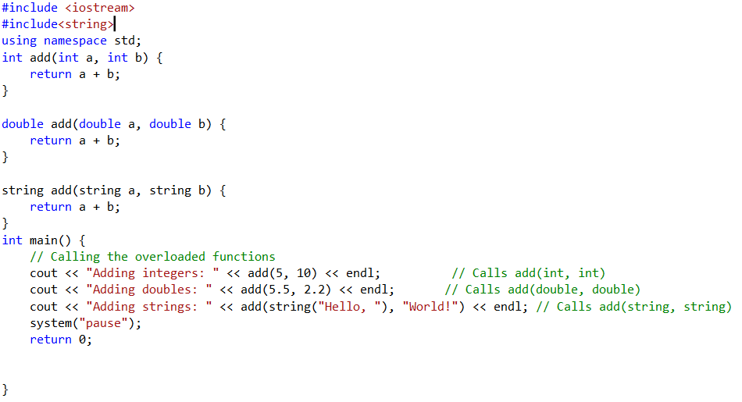
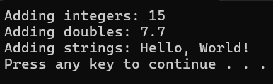
Example

Slide 23
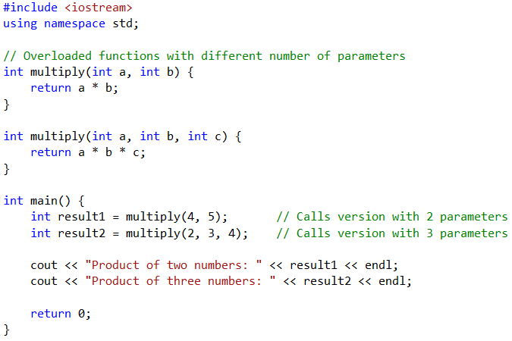
Example
Program Output:
Product of two numbers: 20
Product of three numbers: 24

Slide 24
Function Calling Another Function
it’s common to have a function call another function to modularize tasks and improve reusability
Functions can call other functions as long as they have been declared or defined earlier in the code.
This modular design improves readability, reusability, and maintainability of the code.

Slide 25
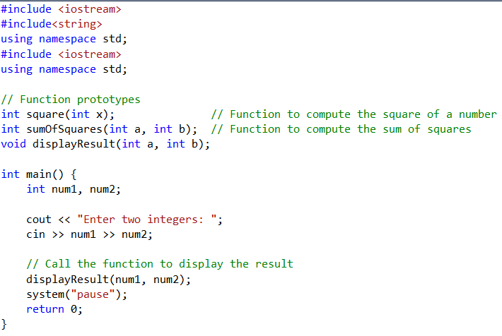
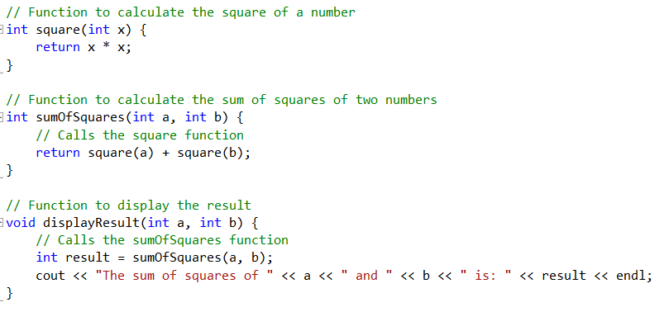
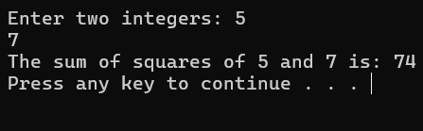
Example

Slide 26
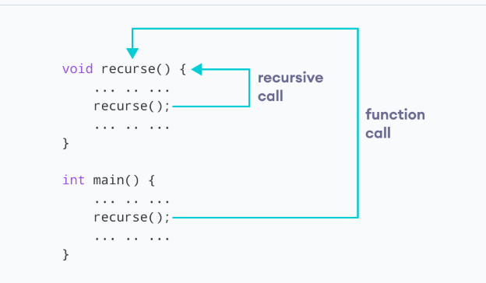
Recursion
A programming technique in which a function calls itself is known as recursion.
A function that calls itself is called recursive function.
A recursive function is a function that calls itself in order to solve a problem.
Recursive functions are commonly used to solve problems that can be broken down into smaller, similar sub-problems, such as calculating factorials

Slide 27
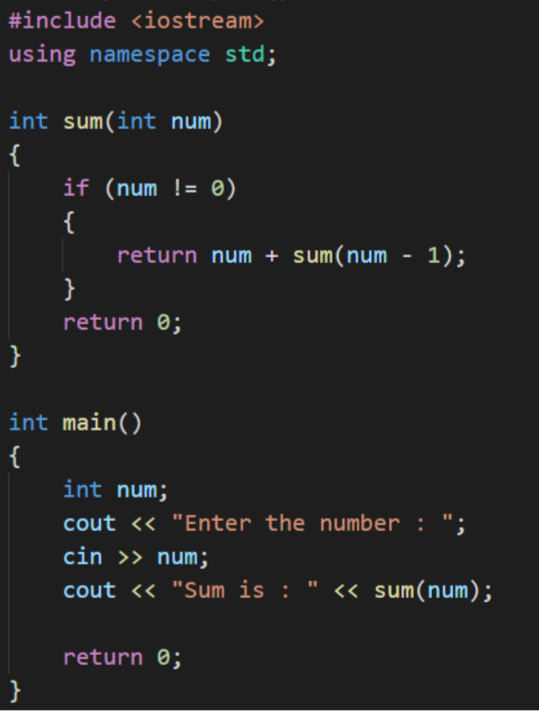
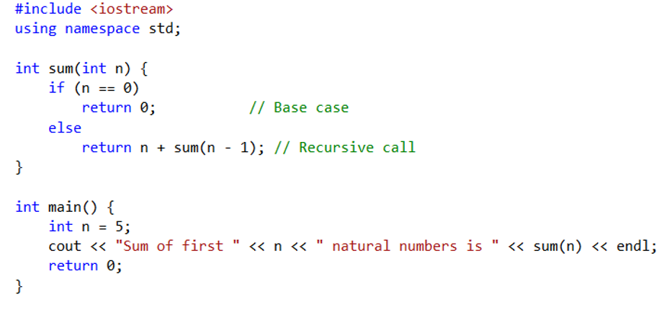
Example: find the sum of all the digits up to a particular number

Slide 28
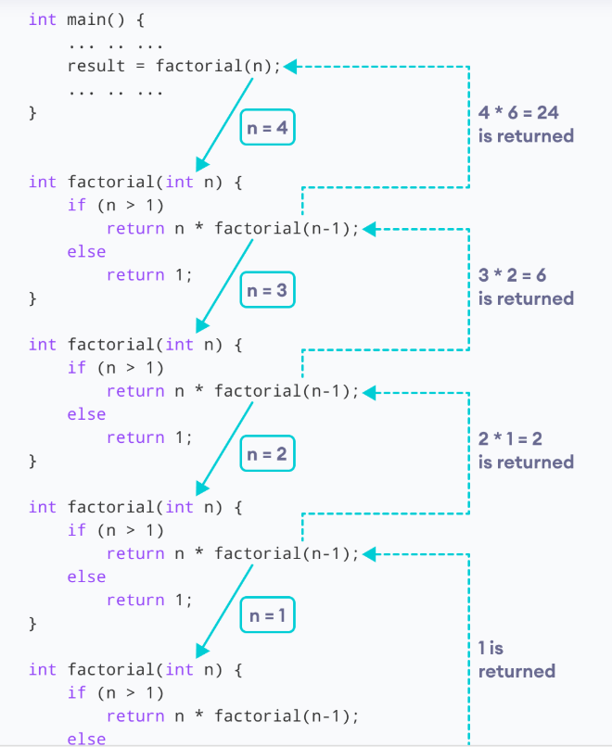
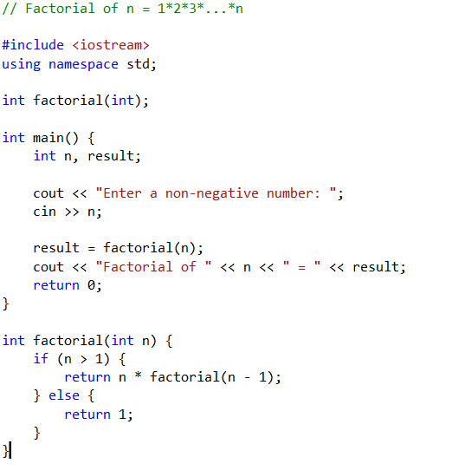

Example : Factorial of a Number Using Recursion

Slide 29
Using Functions in Menu-Driven Programs
Functions can be used
to implement user choices from menu
to implement general-purpose tasks:
Higher-level functions can call general-purpose functions, minimizing the total number of functions and speeding program development time

Slide 30
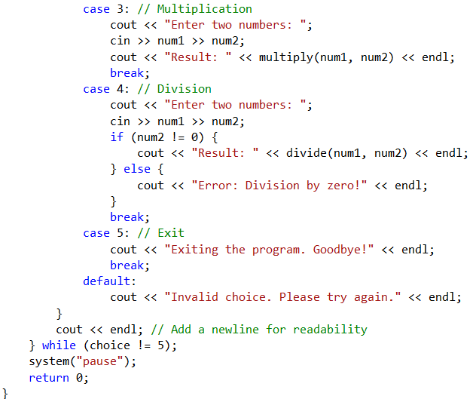
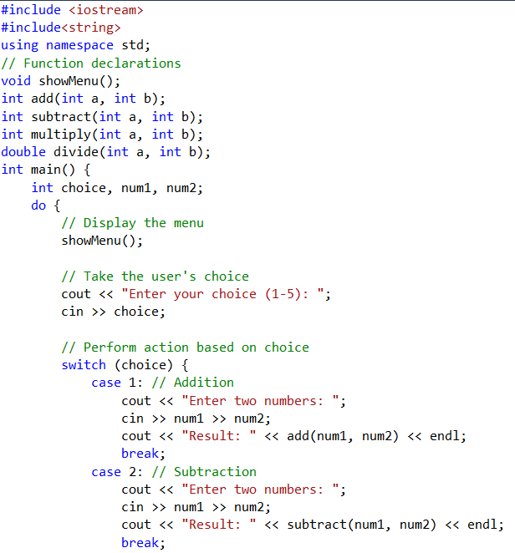
Example :Calculator with a Menu

Slide 31
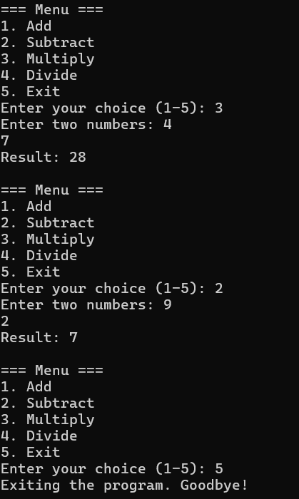
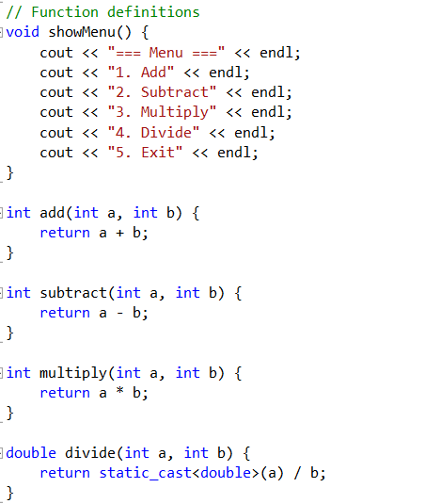
Example:Calculator with a Menu

Slide 32
Local and Global Variables
Variables defined inside a function are local to that function.
They are hidden from the statements in other functions, which normally cannot access them.
Because the variables defined in a function are hidden, other functions may have separate, distinct variables with the same name.
When the function begins, its local variables and its parameter variables are created in memory, and when the function ends, the local variables and parameter variables are destroyed.
This means that any value stored in a local variable is lost between calls to the function in which the variable is declared.

Slide 33
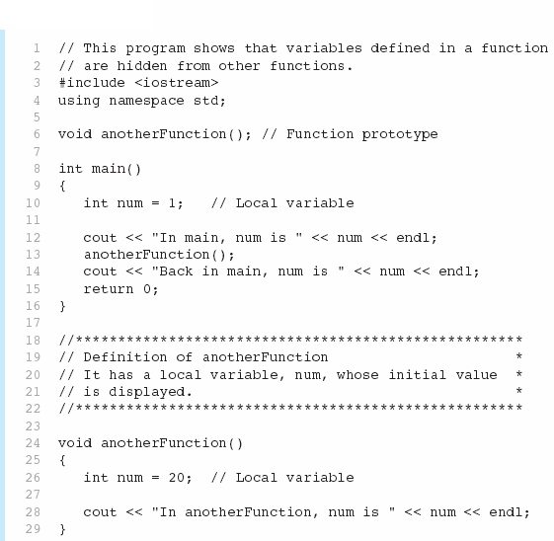

Local Variables in Program 6-16

Slide 34

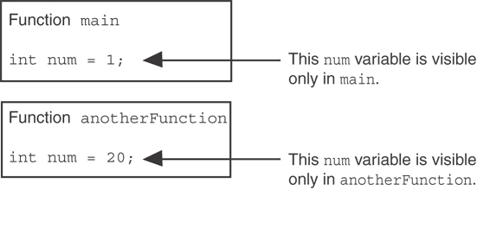
Local Variables in Program 6-16
When the program is executing in main, the num variable defined in main is visible. When anotherFunction is called, however, only variables defined inside it are visible, so the num variable in main is hidden.

Slide 35
Global Variables and Global Constants
A global variable is any variable defined outside all the functions in a program.
The scope of a global variable is the portion of the program from the variable definition to the end.
This means that a global variable can be accessed by all functions that are defined after the global variable is defined.
You should avoid using global variables because they make programs difficult to debug.
Any global that you create should be global constants.

Slide 36
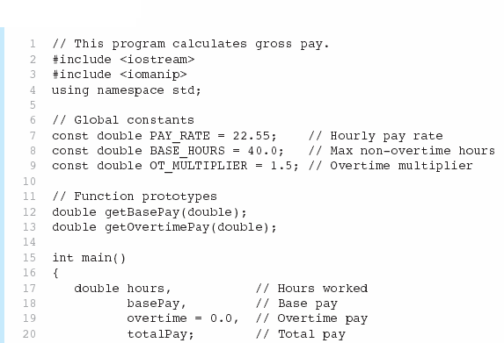

Global Constants in Program 6-19
Global constants defined for values that do not change throughout the program’s execution.

Slide 37



Global Constants in Program 6-19
The constants are then used for those values throughout the program.

Slide 38
Initializing Local and Global Variables
Local variables are not automatically initialized. They must be initialized by programmer.
Global variables (not constants) are automatically initialized to 0 (numeric) or NULL (character) when the variable is defined.

Slide 39
Static Local Variables
Local variables only exist while the function is executing.
When the function terminates, the contents of local variables are lost.
static local variables retain their contents between function calls.
static local variables are defined and initialized only the first time the function is executed.
0 is the default initialization value.

Slide 40
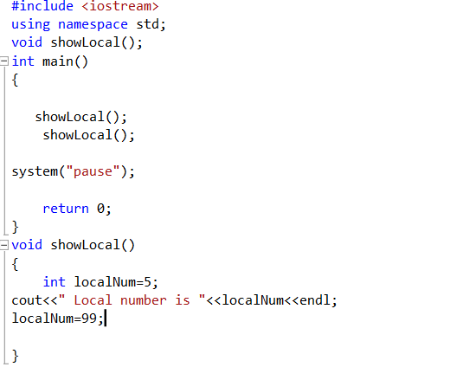
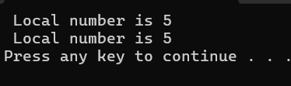
Static Local Variables Example

Slide 41
Static Local Variables Example
In the previous program, each time showLocal is called, the localNum variable is re-created and initialized with the value 5.
But, Different Approach, Using a Static..

Slide 42
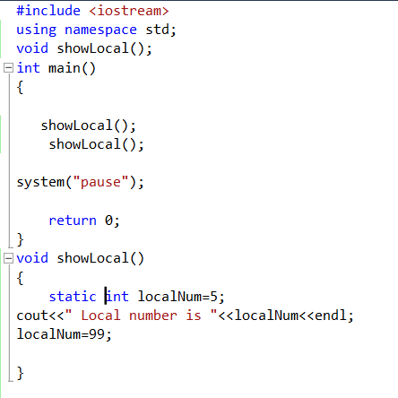
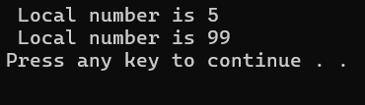
Static Local Variables Example

Slide 43
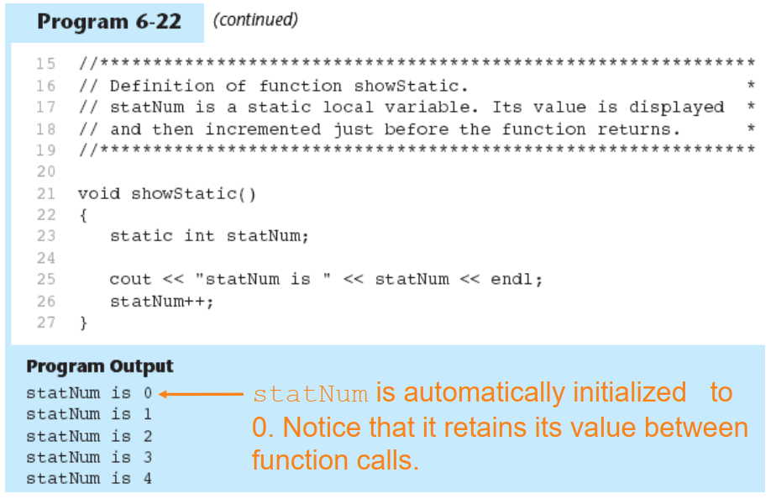
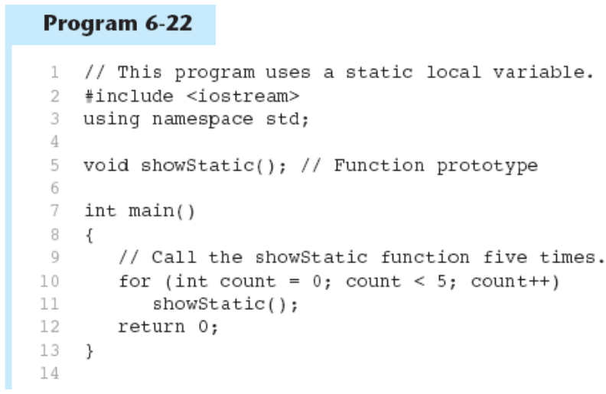
Static Local Variables Example

Slide 44
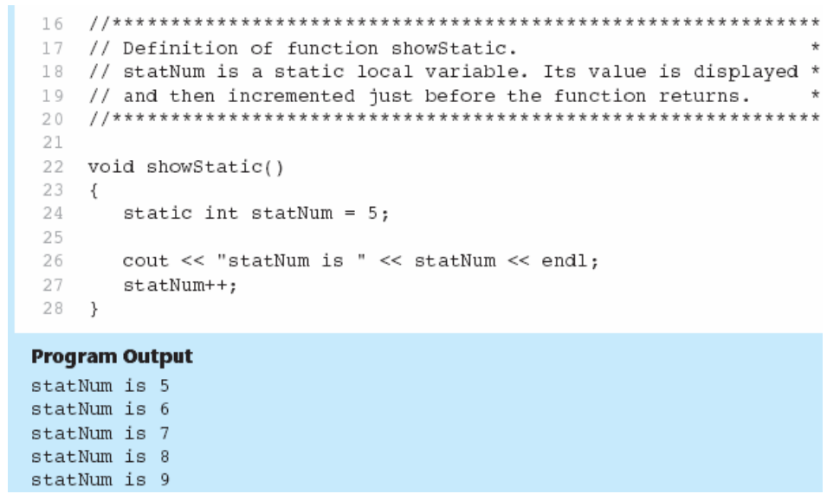
Static Local Variables Example
If you do initialize a local static variable, the initialization only happens once.

Slide 45
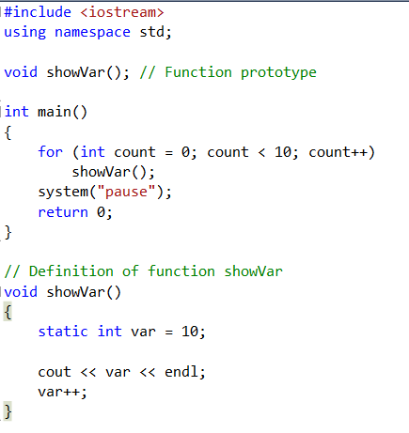
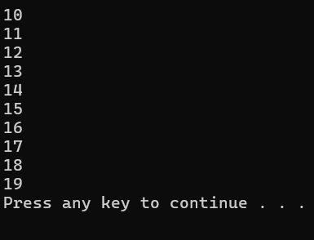
What is the output

Slide 46
Arrays with Function

Slide 47
Pass Arrays to Function
Arrays are always passed by reference even though we do not even write the reference operator (&) in front of the array name.
The “[ ]” in the formal parameter specification indicates that the variable is an array.
To define a function that takes an array parameter, use empty [] for array argument:
// function prototype
void showScores(int []);
// function header
void showScores(int tests[])
To pass an array to a function, just use the array name:
showScores(tests);

Slide 48
Arrays as Function Arguments
It is a good practice to pass the dimension of the array as another parameter.
When passing an array to a function, it is common to pass array size so that function knows how many elements to process:
showScores(tests, ARRAY_SIZE);
Array size must also be reflected in prototype, header:
// function prototype
void showScores(int [], int);
// function header
void showScores(int tests[], int size)

Slide 49
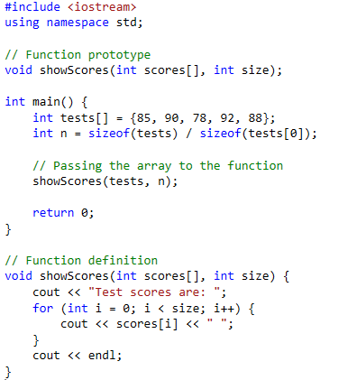
Example
Program Output:
Test scores are: 85 90 78 92 88

Slide 50
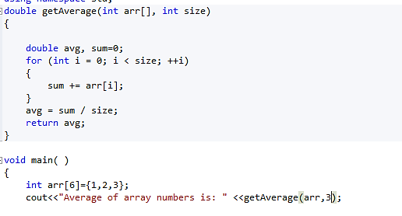
Modifying Arrays in Functions
Array names in functions are like reference variables – changes made to array in a function are reflected in actual array in calling function.

Slide 51
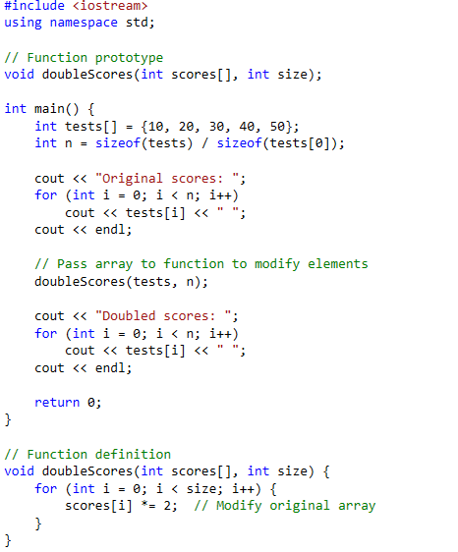
Example
Program Output:
Original scores: 10 20 30 40 50
Doubled scores: 20 40 60 80 100

Slide 52
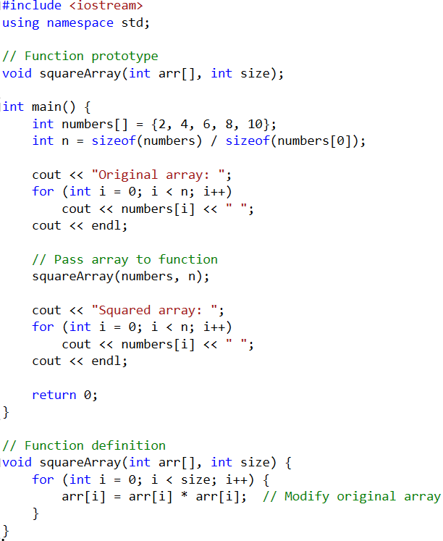
Example
Program Output:
Original array: 2 4 6 8 10
Squared array: 4 16 36 64 100

Slide 53
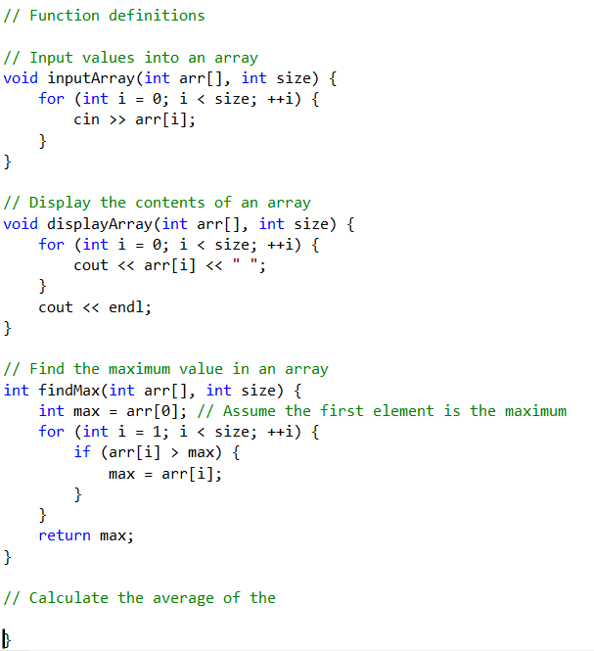
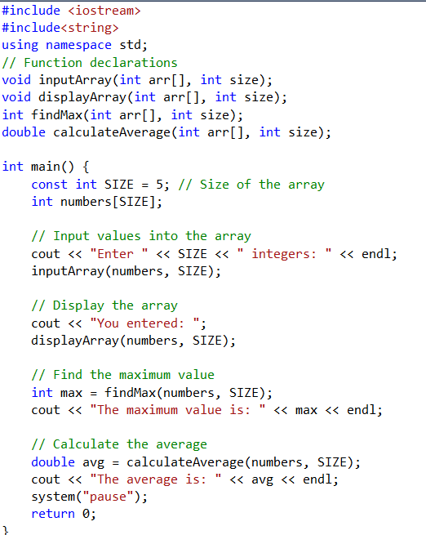
Example

Slide 54
Thank you

